Slide 1

EDGE AI
Anish Sapkota

Slide 2

Edge Computing
At the edge of the network

Slide 3
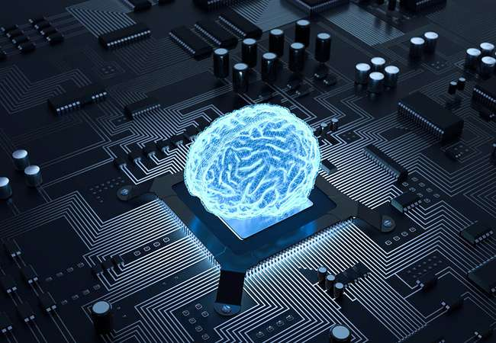
Artificial Intelligence
Simulation of human intelligence

Slide 4

Edge Intelligence
Combination of Edge Computing and Artificial Intelligence

Slide 5
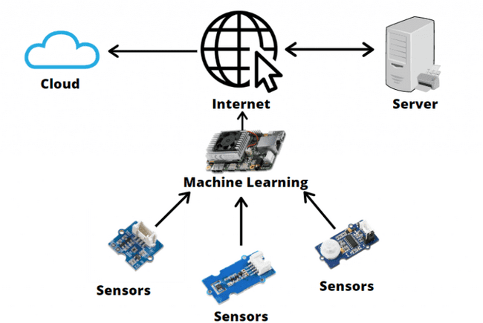
HOW DOES EDGE AI WORK?

Slide 6
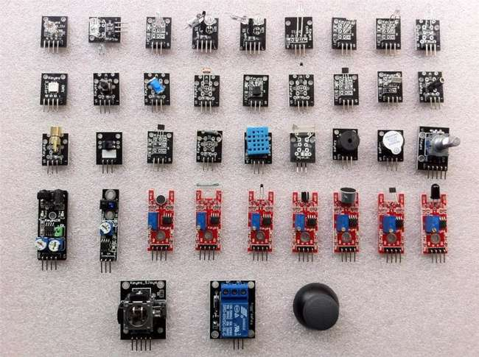
Data Acquisition
Collection of data from sensors
ROM GROUP 5

Slide 7
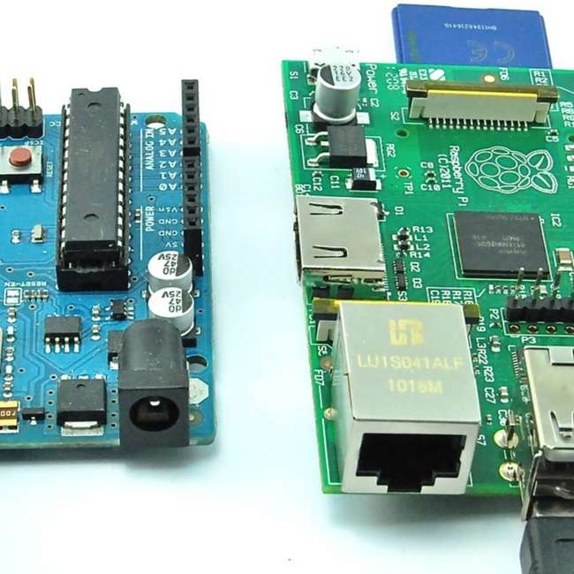
Data Transmission
Sending information to other components in network
ROM GROUP 5

Slide 8
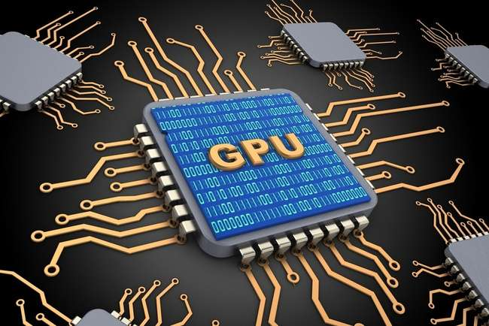
Data Processing & Management
Deployment of AI algorithms on edge devices and Handling
ROM GROUP 5

Slide 9
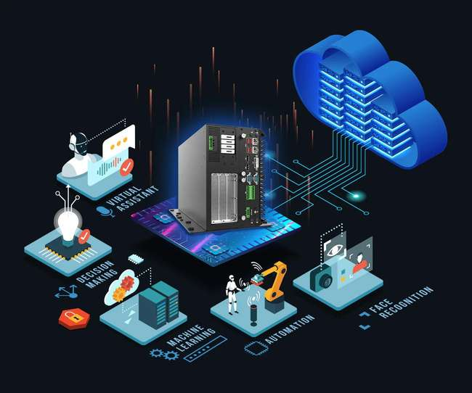
Data Analytics & Visualization
Deployment of AI algorithms on edge devices and Handling
ROM GROUP 5

Slide 10
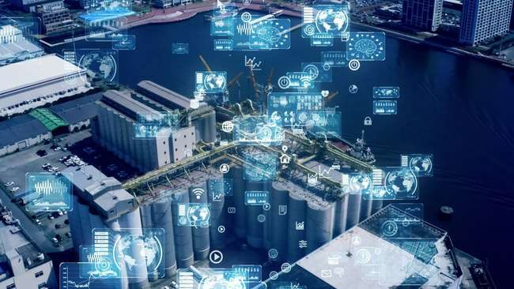
Real-World
Examples
Uses of edge AI in our life

Slide 11
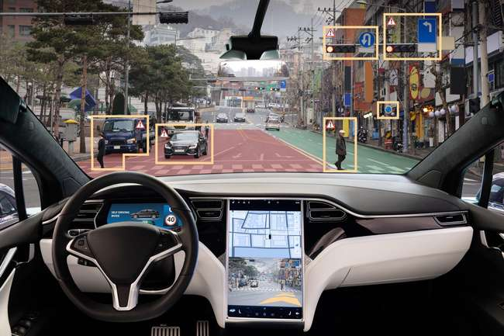
Autonomous Vehicle

Slide 12
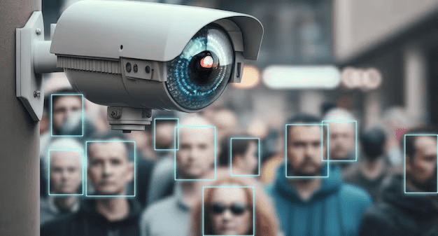
Smart Survilleance Cameras

Slide 13

Remote Patient Monitoring System

Slide 14

Smart Agriculture

Slide 15
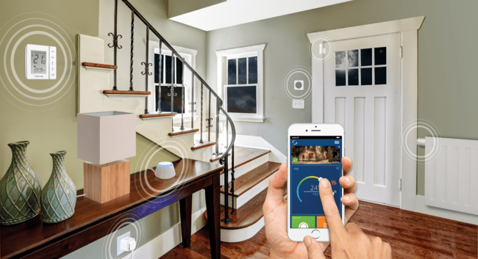
Smart Home

Slide 16
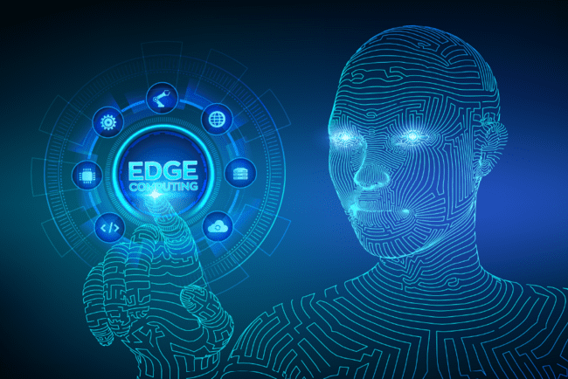
Benefits
Reduced Latency
Bandwidth Efficiency
Enhanced Privacy
Less dependence on clouds

Slide 17

Challenges
Hardware and frameworks
Security and Privacy concern
AI deployment
Training Models

Slide 18
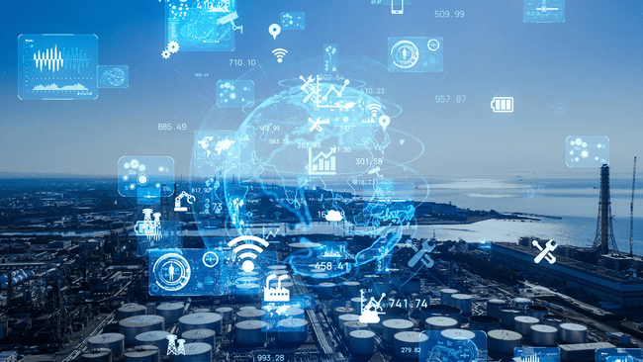
The Future
Robotic Process Automations
Rise of super apps
Advancements in various industries
Neuromorphic Computing

Slide 19
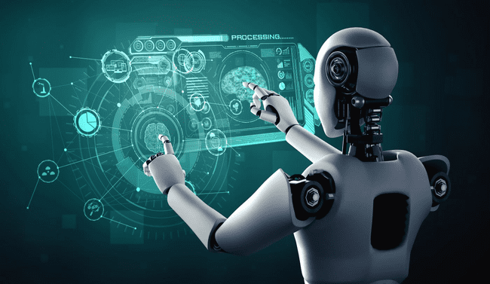
Conclusion
More intelligent devices
Hardware-level security
Secured embedded systems

Slide 20

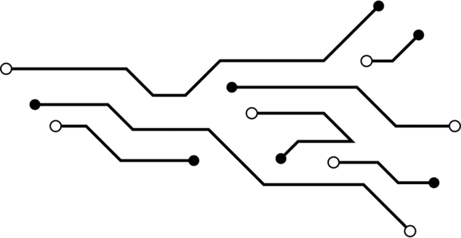

THANKYOU

